Slide 1
A Meta-Analysis of Social Media and Mental Health
Deepthi Tamma

Slide 2

Agenda
Here we list topics to discuss:
Background and Problem Description
Research Discussion
Approach
Data Gathering, Preprocessing & Cleaning
Text Analysis
Semantic Analysis
Conclusion

Slide 3

Introduction and Background
Social interaction is a necessity
Lack of social Interaction leads to loneliness and anxiety
Rise of social media utilization in 2010 - 2011
Social media leads to mental health issues

Slide 4
Problem Description and Investigation
Multiple sources suggest linkage between social media and mental illness
Information Gap
Analyse demographics
Association between social media and depressive symptoms
Software used:
R Studio
MS Excel
Python
Monkey Learn
Tableau

Slide 5

Social Media and its Proposed Impact
Usability
The alarming correlation between social networking usage and mental health
Previous research findings
Literature Review

Slide 6

Research Discussion
Goals:
Evaluate the correlation between social media use and mental health, and their associated risks with high usage
Locate those at risk of mental health issues through social media platforms
Compare and identify the demographics who are at highest risk and the lowest risk with intentions to monitor their distinguishing activity
Determine whether social media activity can predict the decline of one’s mental health
Identify the diagnoses and symptoms of mental illness prominent in high social media use
Focused diagnoses: depression, anxiety, and personality disorders
Our goals intended to confirm and the key points supported in the literature reviews.

Slide 7

Approach
Conducted analysis on how social media is affecting mental health of different age groups.
Used R to for web scraping
Used python for pre-processing
Conduct meta-analysis using natural language processing via machine learning.
Used tableau for befitting visualizations

Slide 8
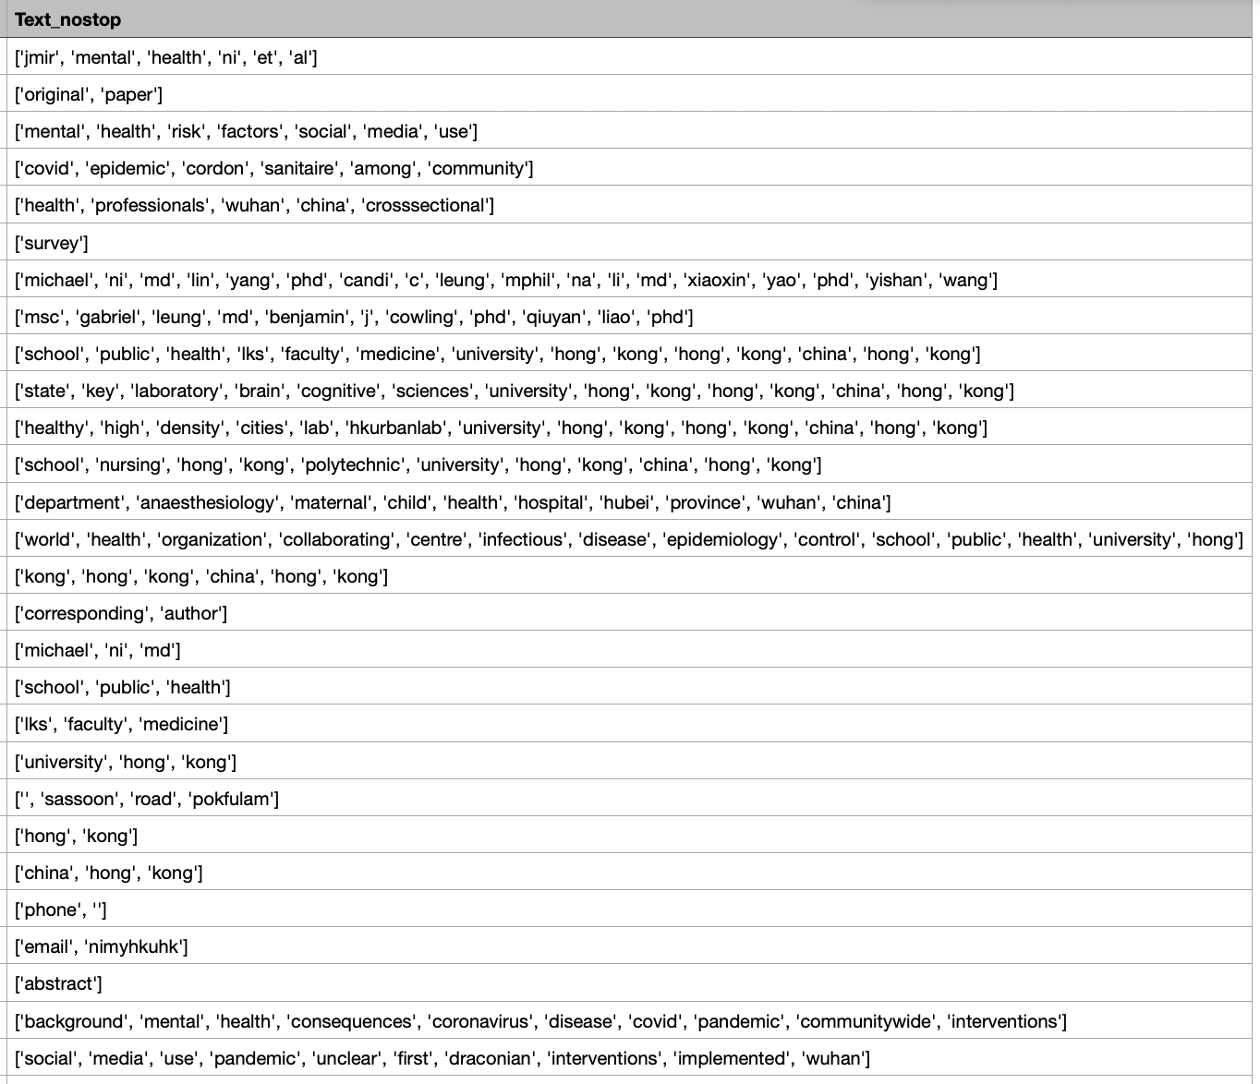
Data Gathering, Preprocessing and Cleaning
Gathering scholarly articles from George Mason’s library database and Google Scholar
Evaluation of articles based on specified keywords: Mental Health, Social Media, Social Networking, Mental illness
Extracted data from articles using R and Python scripts
Converted the files to .CSV to be interpreted by Excel and MonkeyLearn
Additional cleaning to remove any delimiters: numbers, special characters, symbols, and punctuation
Uncleaned .CSV file for further processing

Slide 9
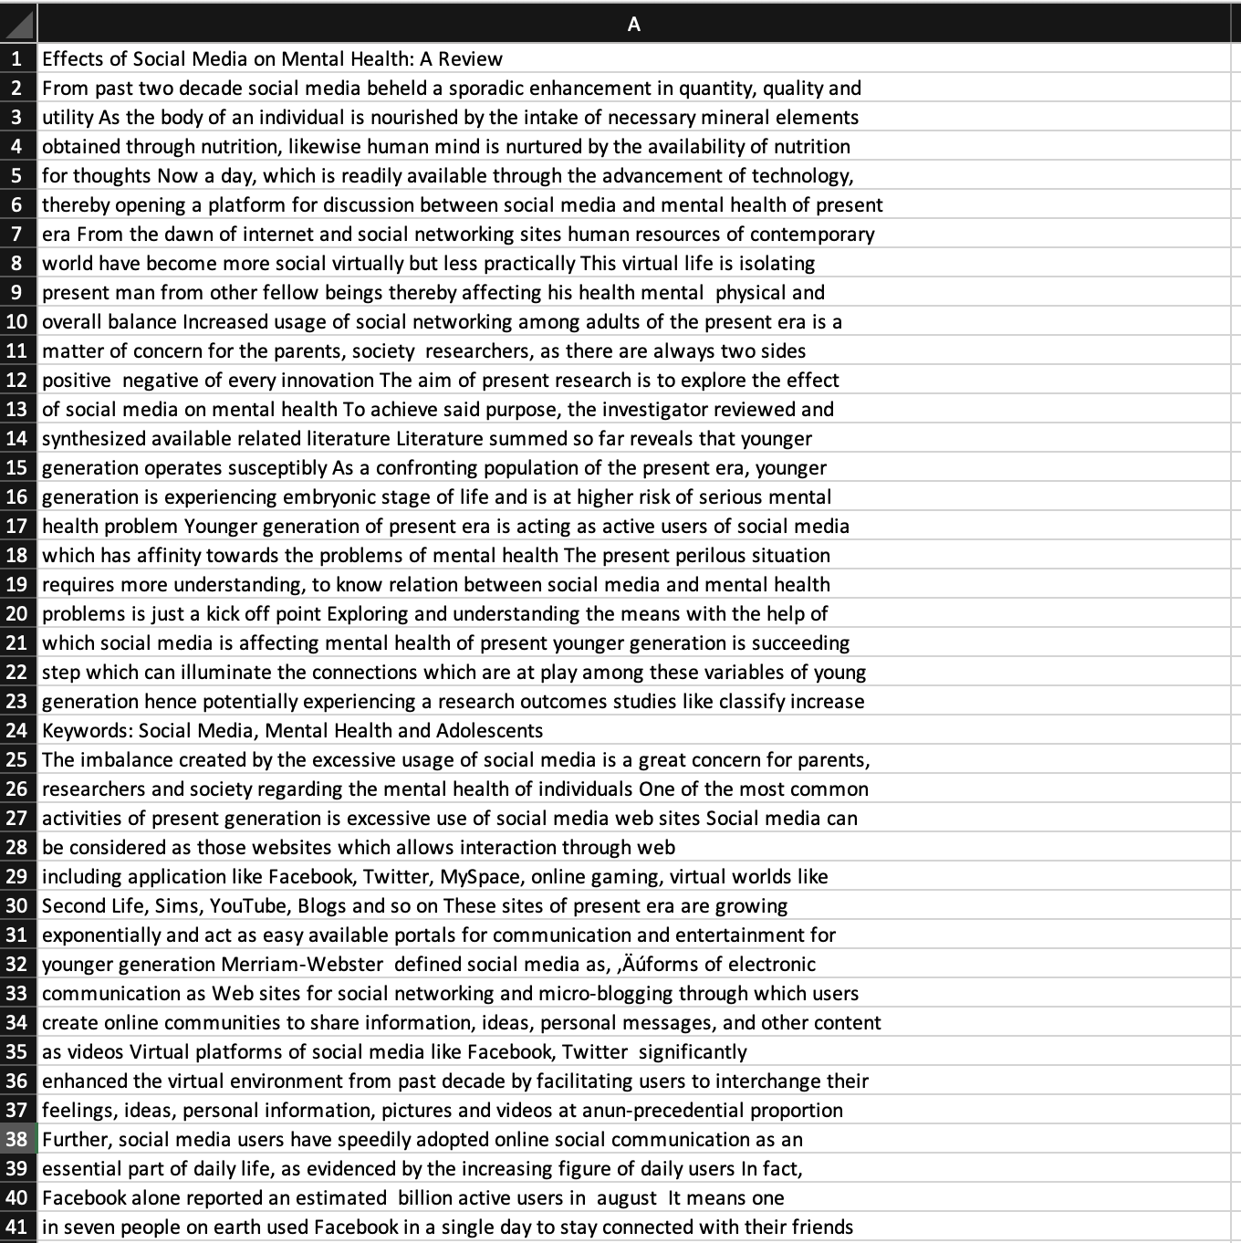
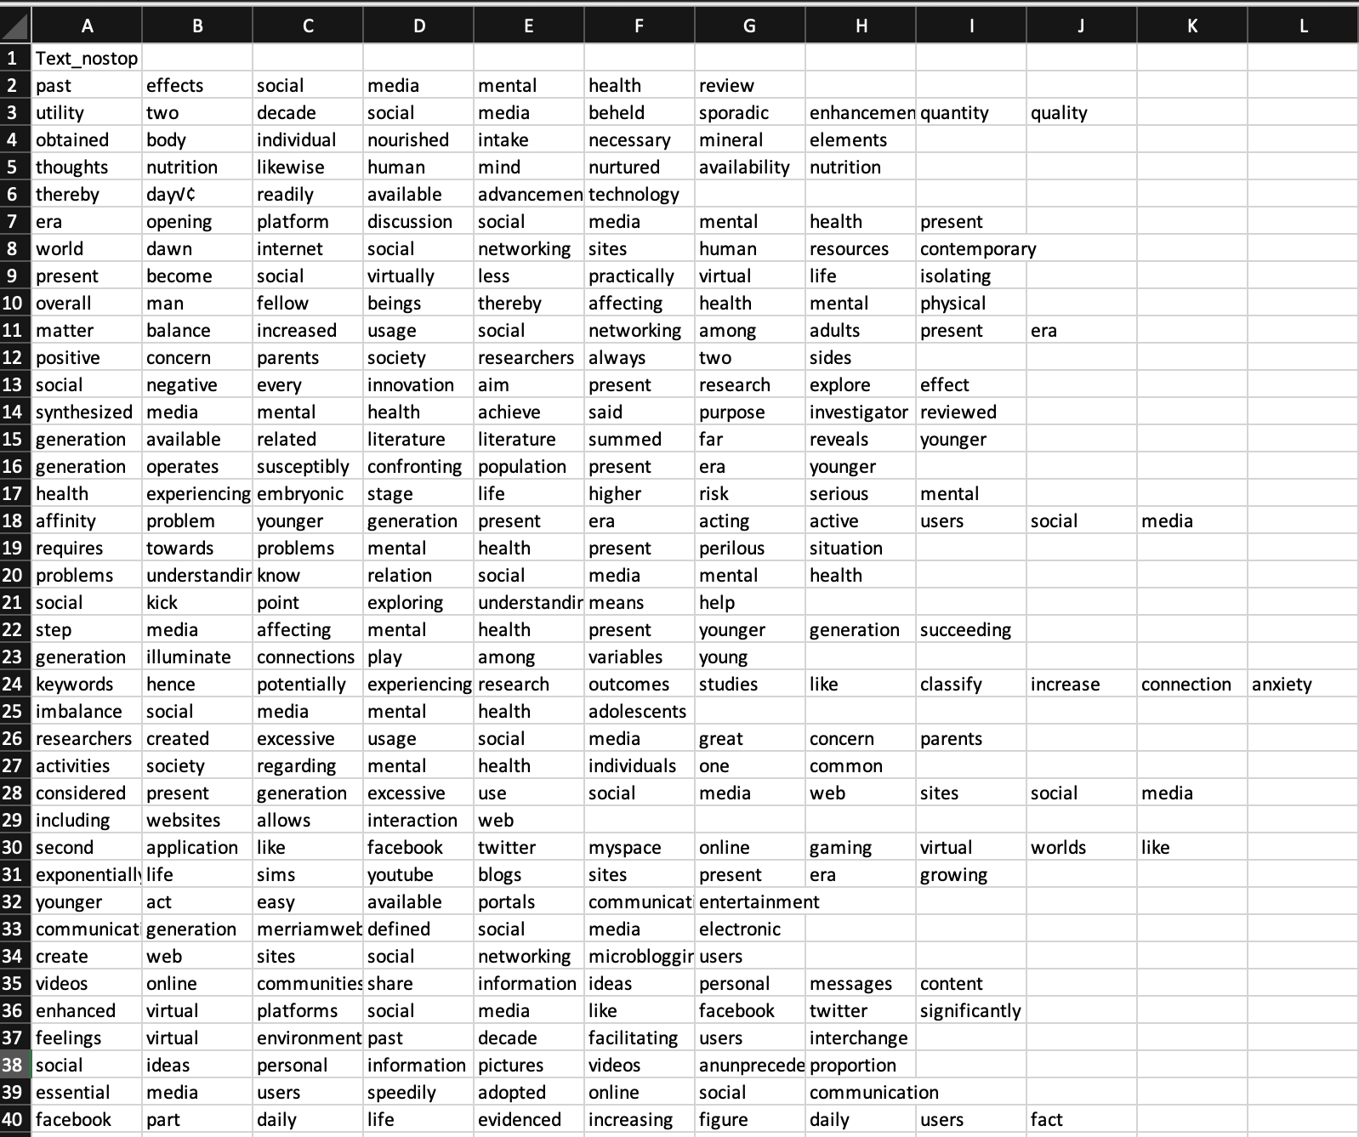
Data Gathering, Preprocessing and Cleaning (cont.)
Unprocessed Text Data (Extracted from Articles)
Processed Tokenized data for Text Mining

Slide 10
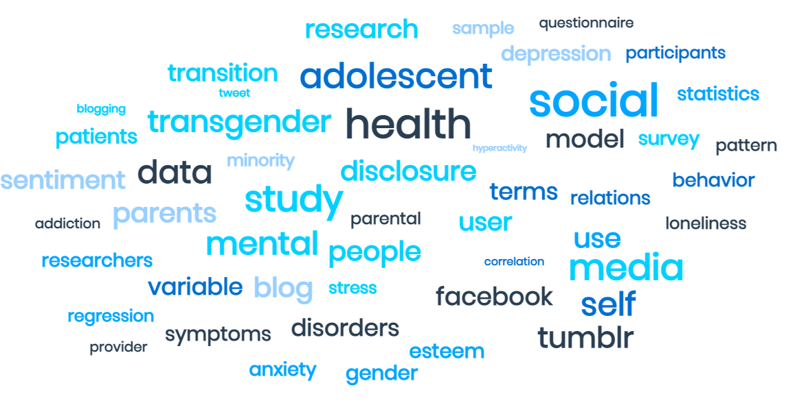
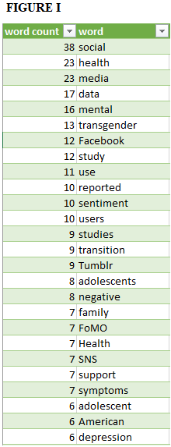
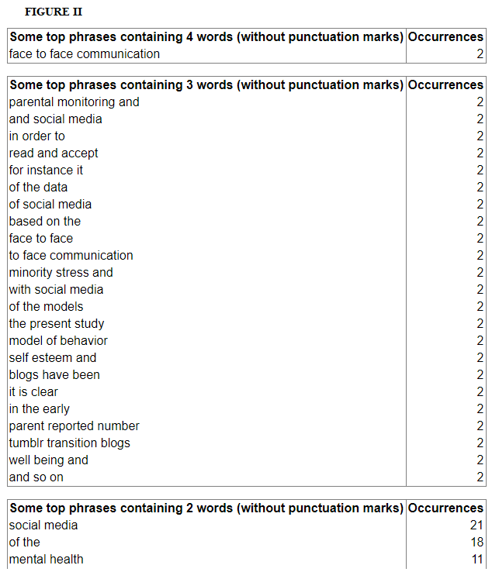
Basic Text Analysis
Cleaned dataset is imported into Monkeylearn to generate basic metadata about the combined dataset.
Generated a word count (single word) that helped us to quickly understand which terms are frequently repeated, showing the areas in which the research was focussed on.
Generated a count of particular phrases that showed up particular times across the dataset to better understand the areas of research.
Word Cloud i.e., visual representation of words is generated that highlights popular words and phrases based upon the frequency and the relevance.

Slide 11
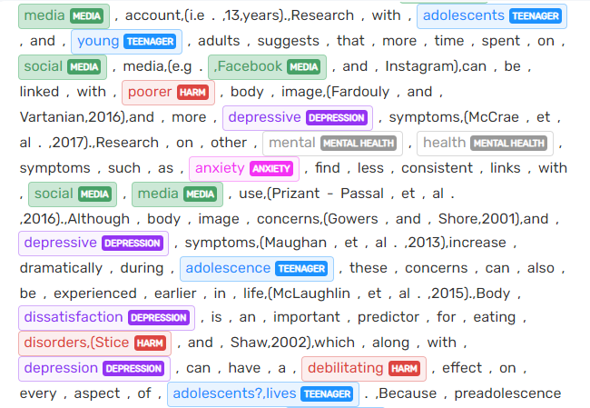
Sentiment Analysis - Machine Learning Process
We decided to do a sentiment analysis, which extracts opinions from text through natural language processing on
The ML Algorithm had to be trained via supervised learning, or manually going over about 20% of the text and tagging words and phrases into categories
Categories were chosen based on their frequency, importance, and ease for the machine to accurately group
Eventually, the ML Algorithm is able to accurately find sentiment with an error rate of about 10-20%, which were either false positives or false negatives
An excerpt of tagged text in MonkeyLearn

Slide 12
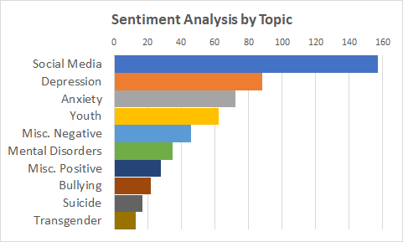
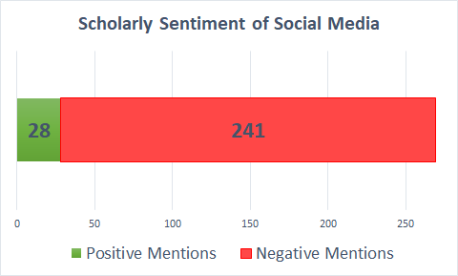
Sentiment Analysis - Findings
Our sentiment analysis extracted more metadata than simple analysis such as a word count or basic data mining
The most frequent individual topic was social media, followed by the main mental disorders of depression and anxiety.
The opinions of the authors about social media and were overwhelmingly one-sided, with 89.6% of sentiments being negative and 10.4% being positive.
The findings indicate that scholars agree that social media usually has a negative effect on the mental health of its users, particularly the young and vulnerable.

Slide 13

Conclusion and Questions
Through sentiment meta-analysis via machine learning, we sought to determine the topics that researchers focus on most when discussing social media and mental health
We gathered that keywords: ‘social’, ‘health’, ‘negative’ were most prevalent in our analysis
This indicates that with heavy social media usage, adolescents, minority groups are at most risk of these mental illnesses: depression, anxiety & ‘miscellaneous mental health’
Challenges faced were due to: removal of delimiters in data, methodology changes, and ML software not fully interpreting the cleaned data imported.
If given the opportunity to revise our research, we’d improve on - extract more articles and cleaner data.
….Questions? :)

